Slide 1
Prime Directive
Regardless of what we discover, we understand and truly believe that everyone did the best job they could given what they knew at the time, their skills and abilities, the resources available, and the situation at hand.

Slide 2
Closing Session
Thanks for coming!

Slide 3

Homework

Slide 4

Agile Estimating and Planning Mike Cohn

Slide 5

Clean Code: A Handbook of Software Craftsmanship Robert Martin

Slide 6

Agile Principles, Patterns, and Practices in C# Robert Martin

Slide 7

Continuous Integration Paul Duvall

Slide 8

Refactoring: Improving the Design of Existing Code Martin Fowler

Slide 9

Refactoring to Patterns Joshua Kerievsky

Slide 10

Working Effectively with Legacy Code Michael Feathers

Slide 11

TDD By Example Kent Beck

Slide 12

The Art of Unit Testing Roy Osherove

Slide 13

xUnit Test Patterns George Meszaros

Slide 14
Slides, Code, (and more!)
http://www.agilefirestarter.com

Slide 15
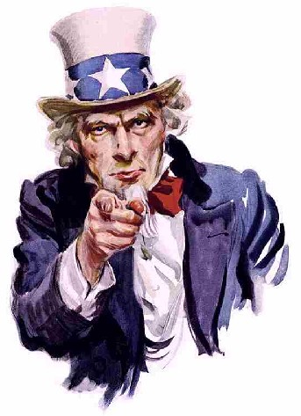
Now help us break this room down!

